Slide 1

CAPSTONE PROJECT
Digits Recognition Neural Network
Final Project
Presented By
Snigdha Sridhar
711721244055
III Btech CSBS
KGiSL Institute of Technology
3/21/2024 Annual Review
1

Slide 2

PROJECT
Classify Handwritten digits using a simple neural network
3/21/2024 Annual Review
2

Slide 3



AGENDA
1. Problem Statement
2. Project Overview
3. End Users
4. Solution and Value Proposition
5. The Wow Factor in Your Solution
6. Modelling
7. Results
3
3/21/2024 Annual Review

Slide 4

PROBLEM STATEMENT
Introduce the challenge of handwritten digit recognition.
Recognising handwritten digits presents a complex task in machine learning and computer vision, requiring advanced algorithms to accurately identify and classify handwritten numbers amidst variations in style, size, and orientation.
Highlight the importance of accurate digit classification in various applications, such as postal services, banking, and automation.
3/21/2024 Annual Review
4

Slide 5

PROJECT OVERVIEW
Provide an overview of the project's goal: to classify handwritten digits using neural networks.
The project aims to utilize neural networks for the classification of handwritten digits.
Mention the utilization of the MNIST dataset, consisting of 60,000 training images and 10,000 testing images of handwritten digits.
3/21/2024 Annual Review
5

Slide 6

WHO ARE THE END USERS?
Identify potential end users of the solution, such as organizations requiring digit recognition for automated processes, developers working on image recognition applications, and researchers in the field of machine learning.
The solution caters to various end users, encompassing businesses seeking automated digit identification capabilities, software developers engaged in image recognition projects, and academic researchers investigating machine learning innovations.
3/21/2024 Annual Review
6

Slide 7

SOLUTION AND ITS VALUE PROPOSITION
The proposed solution is a neural network model designed specifically for handwritten digit recognition.
The value proposition of this solution lies in its ability to significantly enhance efficiency, accuracy, and automation in digit classification tasks. By leveraging advanced neural network algorithms, the model promises to deliver precise and reliable results, thereby streamlining digit recognition processes and minimizing errors.
3/21/2024 Annual Review
7

Slide 8

THE WOW IN YOUR SOLUTION
Highlight unique aspects or features of the solution that differentiate it from traditional methods or other approaches.
Key innovations include advanced feature extraction techniques for enhanced pattern recognition, optimized training algorithms for improved efficiency, and regularization methods to prevent overfitting.
These unique features collectively contribute to superior performance, distinguishing the solution from conventional approaches in digit recognition.
3/21/2024 Annual Review
8

Slide 9
MODELLING
The neural network model for digit recognition begins with an input layer receiving pixel values from the images and an output layer producing classification results for the digits 0 through 9.
Key components include: Activation Functions: Non-linear functions like ReLU in the hidden layer and softmax in the output layer help the model learn and make predictions efficiently.
Optimization Algorithms: Algorithms like Adam or SGD adjust the model's weights during training to minimize prediction errors.
3/21/2024 Annual Review
9

Slide 10
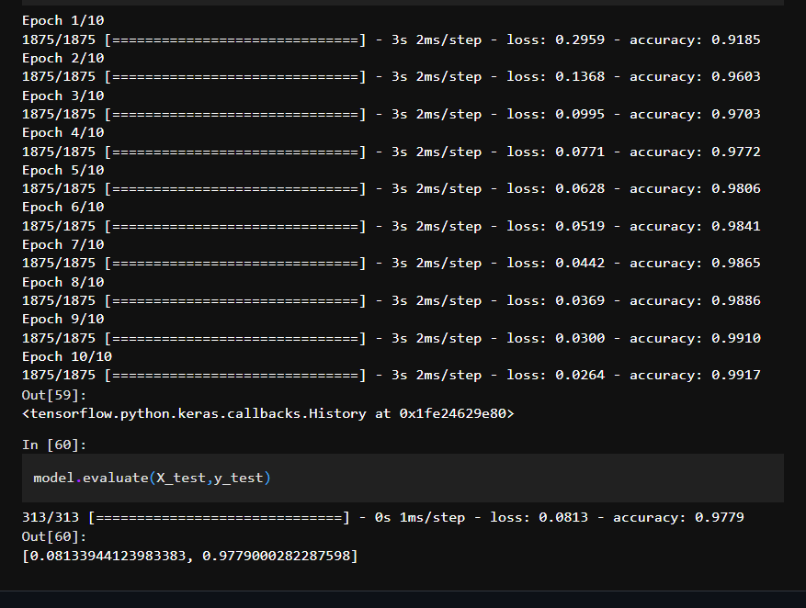
RESULTS
Demo Link
3/21/2024 Annual Review
10

